Slide 1
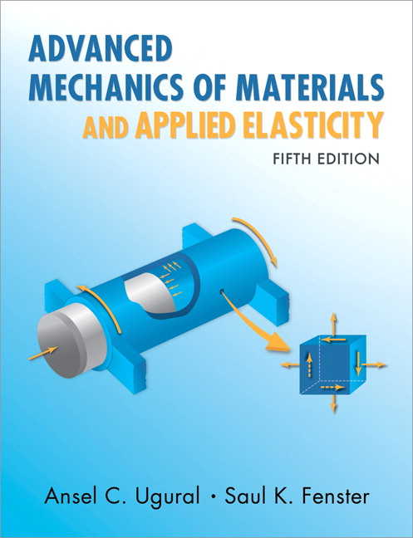
Advanced Mechanics
ANNOUNCE / BUSINESS
HW 4 (due H, 2/6)
HW 5 (due H, 2/13)
Exam 01 grading will be done by next week
NEW STUFF
More failure theory
Fracture Mechanics

Slide 2
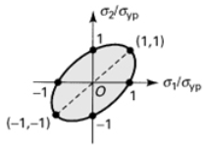
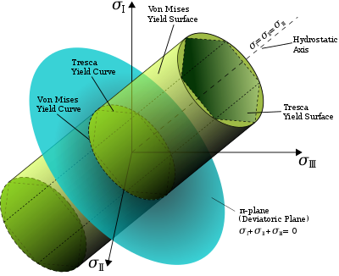
Maximum Distortion Energy Theory
2D failure envelope
3D failure surface
Again, no contribution of hydrostatic stress to failure
Wikipedia

Slide 3


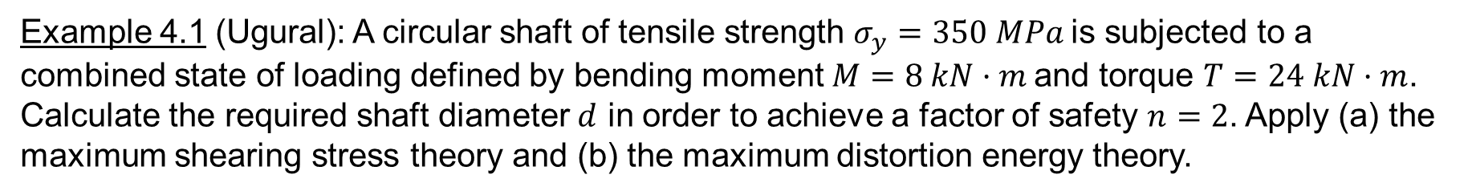
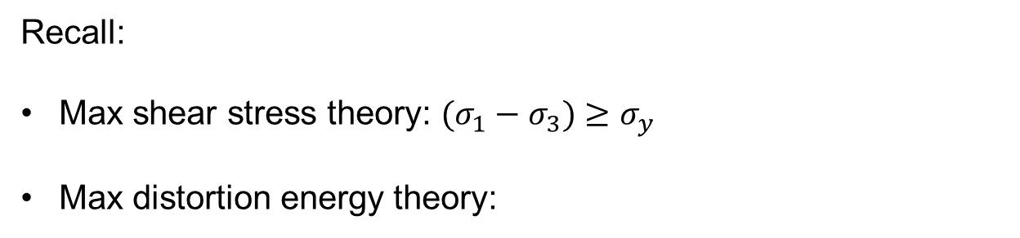

Example 4.1 (Ugural): A circular shaft of tensile strength $σ_{y}=350 MPa$is subjected to a combined state of loading defined by bending moment $M=8 kN·m$and torque $T=24 kN·m$. Calculate the required shaft diameter $d$ in order to achieve a factor of safety $n=2$. Apply (a) the maximum shearing stress theory and (b) the maximum distortion energy theory.
Recall:
Max shear stress theory: $(σ_{1}−σ_{3})≥σ_{y}$
Max distortion energy theory:
$$x$$
$$y$$

Slide 4
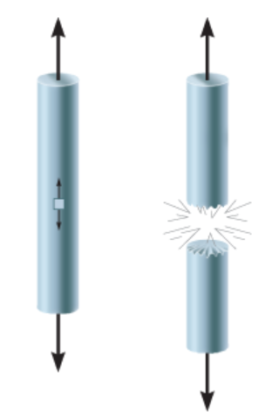
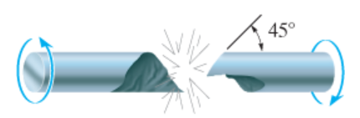
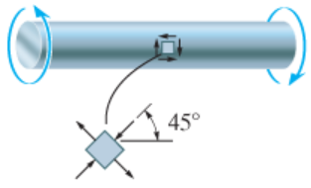
Brittle Material Failure – Observations
Failure surfaces of brittle materials suggest sensitivity to normal stress
Tension
Torsion
Torsion experiments: magnitude of compressive stress (in the rotated coordinate frame) has limited influence on failure, so tension seems to be the key consideration.
Sensitivity to tensile normal stress is due to crack propagation at stress concentrations due to microscopic imperfections (e.g., inclusions, voids, surface indentations, cracks)

Slide 5
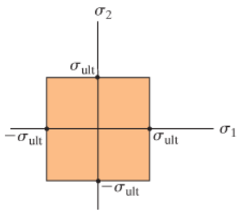
Brittle Failure – Max Normal Stress Theory
Proposed in mid-1800s by W. Rankine
Theory: failure occurs when the largest principal stress exceeds the ultimate strength
Assumes other stresses play no role
Limitations:
only reliable when principal stress with the largest absolute value is tensile (since theory is based on crack growth precipitated by tension)
especially inaccurate when all principal stresses are negative (experience shows that most materials can sustain large compressive hydrostatic stresses)

Slide 6
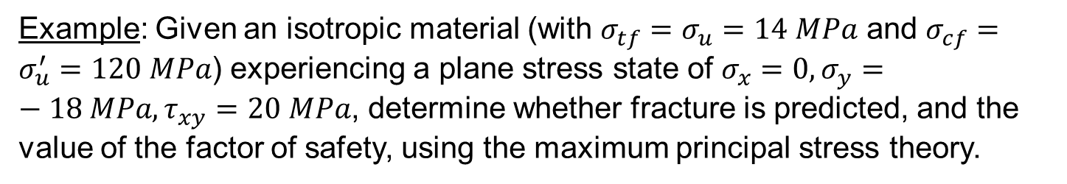


Example: Given an isotropic material (with $σ_{tf}=σ_{u}=14 MPa$ and $σ_{cf}=σ_{u}^{′}=120 MPa$) experiencing a plane stress state of $σ_{x}=0,σ_{y}=−18 MPa,τ_{xy}=20 MPa$, determine whether fracture is predicted, and the value of the factor of safety, using the maximum principal stress theory.
$$20 MPa$$
$$18 MPa$$
Notes:
Cook and Young, p. 55

Slide 7
Failure of Anisotropic Materials
The failure theories we’ve discussed assume isotropy
Anisotropic material failure is more complex and requires different theory that is outside the scope of this course

Slide 8
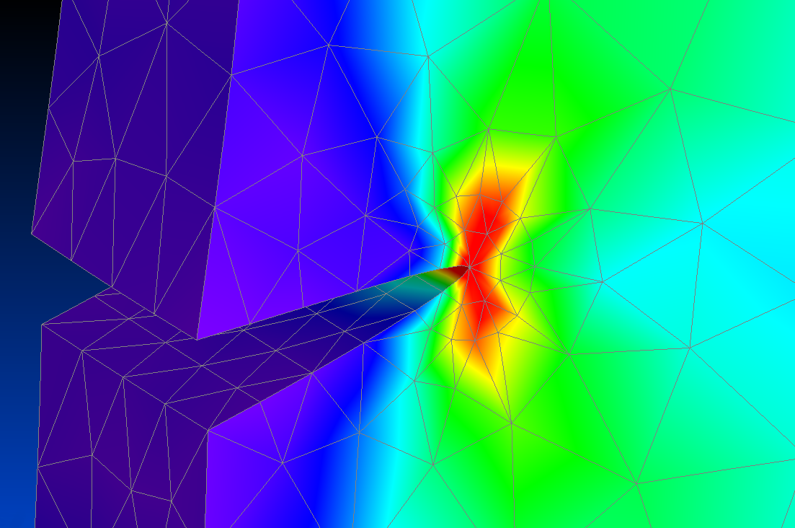
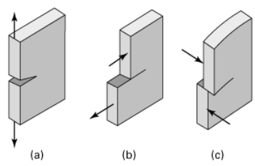
Fracture Mechanics
Focuses on mechanisms of fracture, but can also be applied to a ductile material with a crack
Analysis in vicinity of crack (or a void, inclusion, etc)
One way to address stress concentrations where radius of crack tip is not fully defined
Three modes of crack deformation
(a) Mode I – opening
(b) Mode II – sliding
(c) Mode III – tearing
Mixed modes also possible
* We will be limited to Mode I in this class

Slide 9
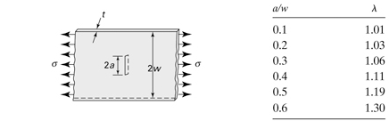

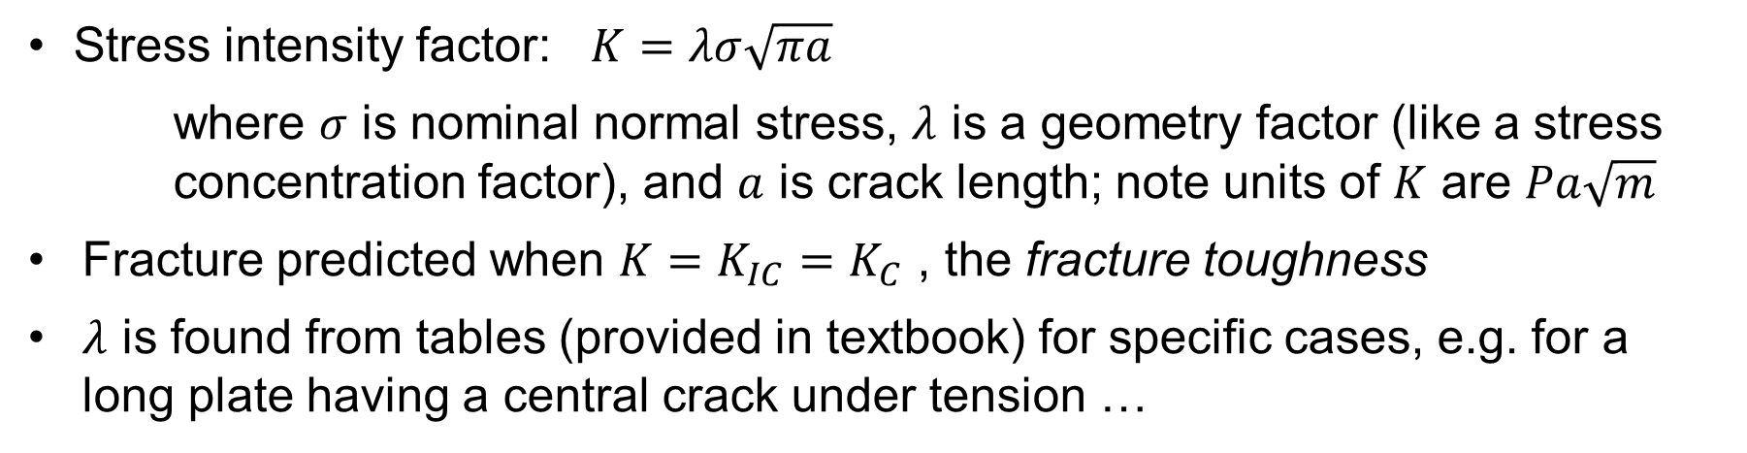
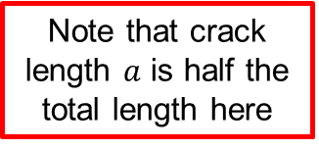
Fracture Mechanics
Stress intensity factor: $K=λσ\sqrt{πa}$
where $σ$ is nominal normal stress, $λ$ is a geometry factor (like a stress concentration factor), and $a$ is crack length; note units of $K$ are $Pa\sqrt{m}$
Fracture predicted when $K=K_{IC}=K_{C}$ , the fracture toughness
$λ$ is found from tables (provided in textbook) for specific cases, e.g. for a long plate having a central crack under tension …
Note that crack length $a$ is half the total length here
2
Only valid when , ensuring plane strain.

Slide 10
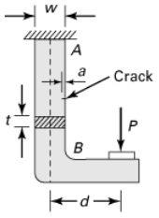
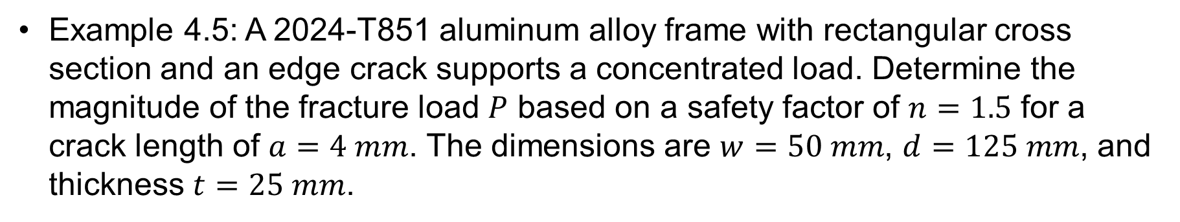
Example
Example 4.5: A 2024-T851 aluminum alloy frame with rectangular cross section and an edge crack supports a concentrated load. Determine the magnitude of the fracture load $P$ based on a safety factor of $n=1.5$ for a crack length of $a=4 mm$. The dimensions are $w=50 mm$, $d=125 mm$, and thickness $t=25 mm$.

Slide 11
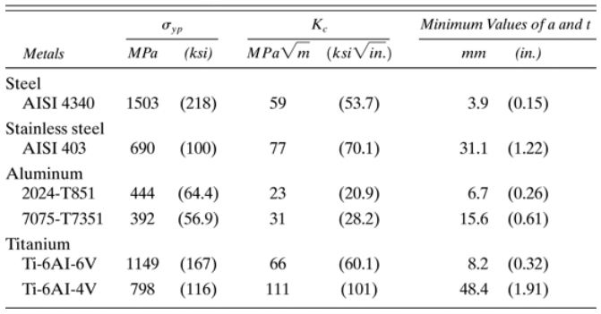
Example (cont’d)

Slide 12
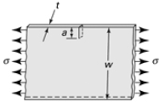
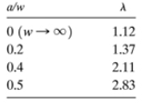
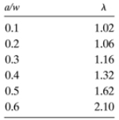

Example (cont’d)

